Slide 1
Algorithm Analysis
and Recursion

Slide 2
Algorithm
An algorithm is a set of instructions to be followed to solve a problem.
  There can be more than one solution (more than one algorithm) to solve a given problem.
  An algorithm can be implemented using different programming languages on different platforms.
An algorithm must be correct. It should correctly solve the problem.
  e.g. For sorting, this means even if (1) the input is already sorted, or (2) it contains repeated elements.
Once we have a correct algorithm for a problem, we have to determine the efficiency of that algorithm.

Slide 3
Algorithmic Performance
There are two aspects of algorithmic performance:
Time
    Instructions take time.
    How fast does the algorithm perform?
    What affects its runtime?
Space
    Data structures take space
    What kind of data structures can be used?
    How does choice of data structure affect the runtime?
We will focus on time:
  How to estimate the time required for an algorithm
  How to reduce the time required

Slide 4
Analysis of Algorithms
When we analyze algorithms, we should employ mathematical techniques that analyze algorithms independently of specific implementations, computers, or data.
To analyze algorithms:
  First, we start to count the number of significant operations in a particular solution to assess its efficiency.
  Then, we will express the efficiency of algorithms using growth functions.

Slide 5
The Execution Time of Algorithms
Each operation in an algorithm (or a program) has a cost.
➔ Each operation takes a certain of time.
count = count + 1; ➔ take a certain amount of time, but it is constant
A sequence of operations:
count = count + 1; Cost: c₁
sum = sum + count; Cost: c₂
➔ Total Cost = c₁ + c₂

Slide 6
The Execution Time of Algorithms (cont.)
Example: Simple If-Statement
Cost Times
if (n < 0) c1 1
absval = -n c2 1
else
absval = n; c3 1
Total Cost <= c1 + max(c2,c3)

Slide 7
General Rules for Estimation
Loops: The running time of a loop is at most the running time of the statements inside of that loop times the number of iterations.
Nested Loops: Running time of a nested loop containing a statement in the inner most loop is the running time of statement multiplied by the product of the sized of all loops.
Consecutive Statements: Just add the running times of those consecutive statements.
If/Else: Never more than the running time of the test plus the larger of running times of S1 and S2.

Slide 8
Order-of-Magnitude Analysis and Big O Notation
If Algorithm A requires time proportional to g(n), Algorithm A is said to be order g(n), and it is denoted as O(g(n)).
The function g(n) is called the algorithm’s growth-rate function.
Since the capital O is used in the notation, this notation is called the Big O notation.
If Algorithm A requires time proportional to n², it is O(n²).
If Algorithm A requires time proportional to n, it is O(n).

Slide 9
Growth-Rate Functions
O(1) Time requirement is constant, and it is independent of the problem’s size.
O(log₂n) Time requirement for a logarithmic algorithm increases increases slowly
as the problem size increases.
O(n) Time requirement for a linear algorithm increases directly with the size
of the problem.
O(n*log₂n) Time requirement for a n*log₂n algorithm increases more rapidly than
a linear algorithm.
O(n²) Time requirement for a quadratic algorithm increases rapidly with the
size of the problem.
O(n³) Time requirement for a cubic algorithm increases more rapidly with the
size of the problem than the time requirement for a quadratic algorithm.
O(2^{n}) As the size of the problem increases, the time requirement for an
exponential algorithm increases too rapidly to be practical.

Slide 10
Growth-Rate Functions
If an algorithm takes 1 second to run with the problem size 8, what is the time requirement (approximately) for that algorithm with the problem size 16?
If its order is:
O(1) ➔ T(n) = 1 second
O(log₂n) ➔ T(n) = (1*log₂16) / log₂8 = 4/3 seconds
O(n) ➔ T(n) = (1*16) / 8 = 2 seconds
O(n*log₂n) ➔ T(n) = (1*16*log₂16) / 8*log₂8 = 8/3 seconds
O(n²) ➔ T(n) = (1*16²) / 8² = 4 seconds
O(n³) ➔ T(n) = (1*16³) / 8³ = 8 seconds
O(2^{n}) ➔ T(n) = (1*2¹⁶) / 2⁸ = 2⁸ seconds = 256 seconds

Slide 11
Growth-Rate Functions – Example1
Cost Times
i = 1; c1 1
sum = 0; c2 1
while (i <= n) { c3 n+1
i = i + 1; c4 n
sum = sum + i; c5 n
}
T(n) = c1 + c2 + (n+1)*c3 + n*c4 + n*c5
= (c3+c4+c5)*n + (c1+c2+c3)
= a*n + b
➔ So, the growth-rate function for this algorithm is O(n)

Slide 12
Growth-Rate Functions – Example2
Cost Times
i=1; c1 1
sum = 0; c2 1
while (i <= n) { c3 n+1
j=1; c4 n
while (j <= n) { c5 n*(n+1)
sum = sum + i; c6 n*n
j = j + 1; c7 n*n
}
i = i +1; c8 n
}
T(n) = c1 + c2 + (n+1)*c3 + n*c4 + n*(n+1)*c5+n*n*c6+n*n*c7+n*c8
= (c5+c6+c7)*n² + (c3+c4+c5+c8)*n + (c1+c2+c3)
= a*n² + b*n + c
➔ So, the growth-rate function for this algorithm is O(n²)

Slide 13
More Recursive Algorithms
int fact(int n) {
if (n ==0)
return (1);
else
return (n * fact(n-1));
}
T(n) = T(n-1) + c
= (T(n-2) + c) + c
= (T(n-3) + c) + c + c
= (T(n-i) + i*c)
when i=n → T(0) + n*c ➔ T(n) = O(n)

Slide 14
Tracing the call fact (3)
N = 0 if (N==0) true return (1)
N = 1 if (N==0) false return (1*fact(0))
N = 2 if (N==0) false return (2*fact(1))
N = 3 if (N==0) false return (3*fact(2))
After 3rd call
N = 3 if (N==0) false return (3*fact(2))
After original call
N = 2 if (N==0) false return (2*fact(1))
N = 3 if (N==0) false return (3*fact(2))
After 1st call
N = 1 if (N==0) false return (1*fact(0))
N = 2 if (N==0) false return (2*fact(1))
N = 3 if (N==0) false return (3*fact(2))
After 2nd call

Slide 15
Tracing the call fact (3)
N = 1 if (N==0) false return (1* 1)
N = 2 if (N==0) false return (2*fact(1))
N = 3 if (N==0) false return (3*fact(2))
After return from 3rd call
N = 2 if (N==0) false return (2* 1)
N = 3 if (N==0) false return (3*fact(2))
After return from 2nd call
N = 3 if (N==0) false return (3* 2)
After return from 1st call
return 6

Slide 16
What to Analyze
An algorithm can require different times to solve different problems of the same size.
  Eg. Searching an item in a list of n elements using sequential search. ➔ Cost: 1,2,...,n
Worst-Case Analysis –The maximum amount of time that an algorithm require to solve a problem of size n.
  This gives an upper bound for the time complexity of an algorithm.
  Normally, we try to find worst-case behavior of an algorithm.
Best-Case Analysis –The minimum amount of time that an algorithm require to solve a problem of size n.
  The best case behavior of an algorithm is NOT so useful.
Average-Case Analysis –The average amount of time that an algorithm require to solve a problem of size n.
  Sometimes, it is difficult to find the average-case behavior of an algorithm.
  We have to look at all possible data organizations of a given size n, and their distribution probabilities of these organizations.
  Worst-case analysis is more common than average-case analysis.

Slide 17
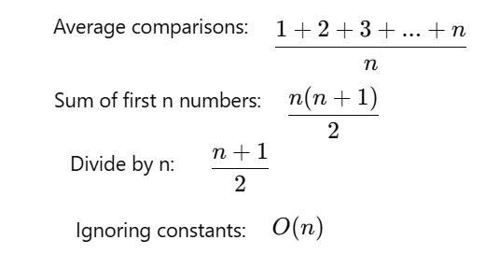
Sequential Search
int sequentialSearch(const int a[], int item, int n){
for (int i = 0; i < n && a[i]!= item; i++);
if (i == n)
return –1;
return i;
}
Successful Search:
Best-Case: item is in the first location of the array ➔O(1)
Worst-Case: item is in the last location of the array ➔O(n)
Average-Case: The number of key comparisons 1, 2, ..., n

Slide 18
Binary Search
We can do binary search if the array is sorted:
int binarySearch(int a[], int size, int x) {
int low =0;
int high = size –1;
int mid; // mid will be the index of
// target when it’s found.
while (low <= high) {
mid = (low + high)/2;
if (a[mid] < x)
low = mid + 1;
else if (a[mid] > x)
high = mid – 1;
else
return mid;
}
return –1;
}

Slide 19
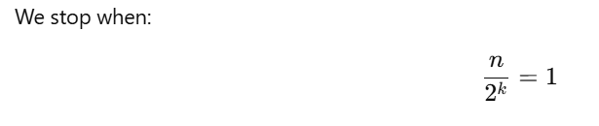
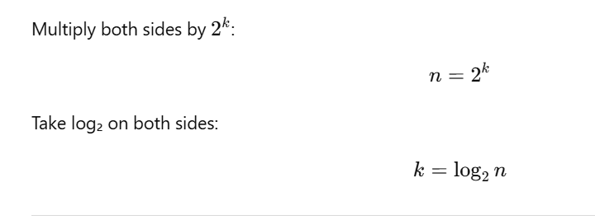
Binary Search – Analysis
Step | Remaining Elements
1 | n/2
2 | n/4
3 | n/8
k | n / 2ᵏ

Slide 20
How much better is O(log₂n)?
n O(log₂n)
16 4
64 6
256 8
1024 10
16,384 14
131,072 17
262,144 18
524,288 19
1,048,576 20
1,073,741,824 30

